Slide 1
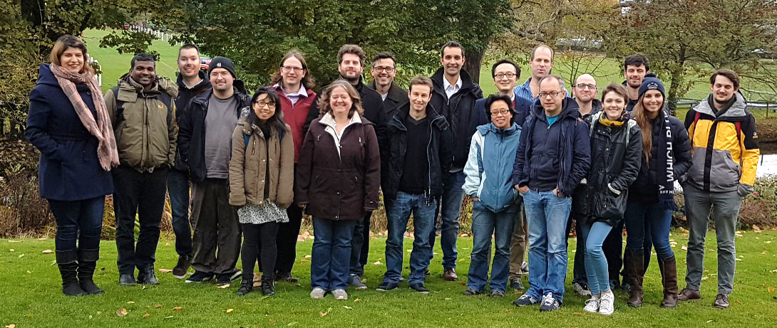





Managing high-density pins for the XChem facility with ISPyB
Alice Douangamath - I04-1/XChem

Slide 2
Plan
Background on fragment screening and XChem
Why high-density pin?
XChem workflow and experience from collecting data from high density pin.

Slide 3
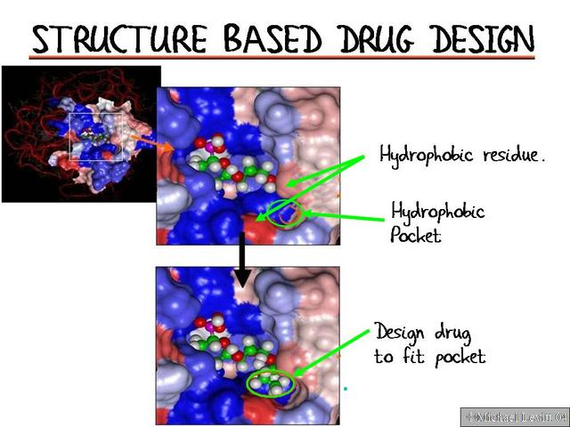
Structure-based drug design
Biophysics
Measure potency
Medicinal & synthetic
Chemists
100s of compounds
Computational chemists
Large research effort
100s of near-identical crystal structures

Slide 4
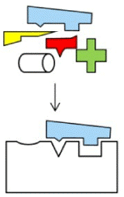
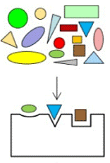
Fragment screening
Conventional screening
Searching for potent molecules
Complex molecules → Low probability
Fragment screening
Guaranteed binding – but weak
Potency through chemical elaboration
100,000’s complex molecules
100-1000’s of small molecules
Drug target
Drug target
≈
10¹⁸
complex molecules
1000
small molecules

Slide 5
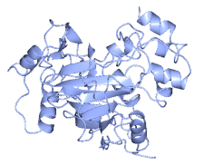
Screening for fragments: conventional
Fragment Library
Binding Assay
Structure
Current practice: pre-select by biophysics Limited sensitivity!
Still need crystal structure
Notes:
Best practice

Slide 6
Screening for fragments: XChem
Fragment Library
Binding Assay
Structure
Current practice: pre-select by biophysics Limited sensitivity!
Still need crystal structure
Better: screen by crystal structure
Very sensitive! High compound conc.!
Historically: far too difficult 100s of crystal structures…
But technology took off – synchrotrons, detectors, robots, algorithms
Job for a facility
Make it fast
and accessible
Notes:
Not new to do it this way – was the original approach. E.g. Astex. But we wanted to do it fast and accessible. (Add bullet to slide: “job for facility”)

Slide 7
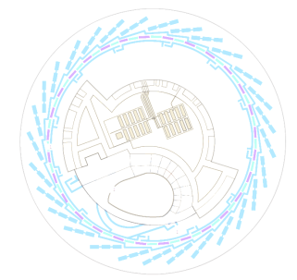
XChem: order of magnitude speedup
Crystal generation
Conventionally
Now @ Diamond
Adding compounds to crystals
weeks
30 min
Crystal harvesting and logistics
900 compounds
3 months
1 week
1.5 day
1000 crystals
1 week
Automated data collection
3 weeks
(1.6 days)
Finding hits
1 month
hours/days
Compound elaboration (synthesis)
Spurlino, Meth Enz, 2011

Slide 8
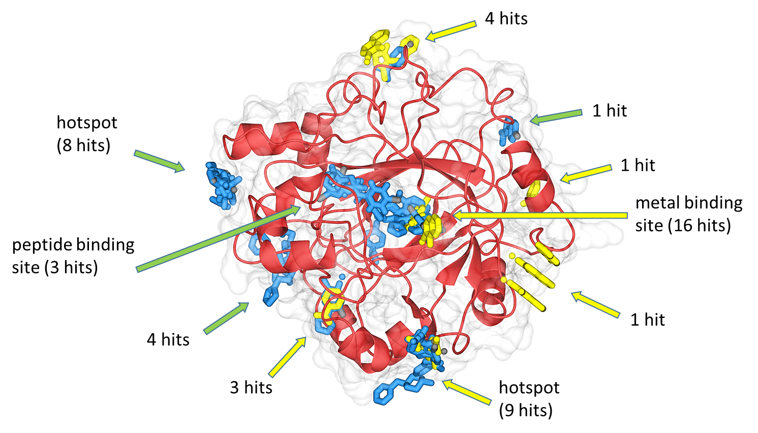
Ideal readout: full structural view
JMJD2D, a histone lysine demethylase
Notes:
As expected

Slide 9
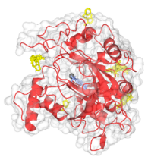
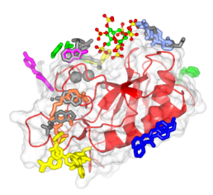
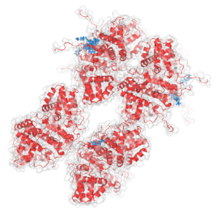
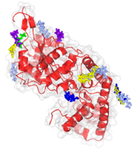
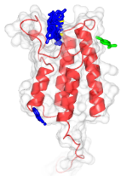
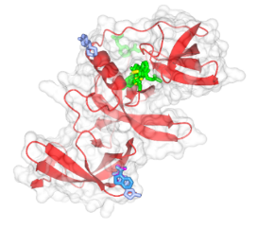
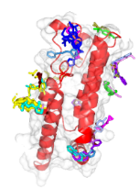
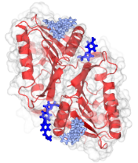
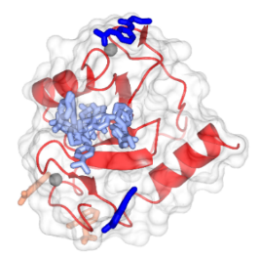
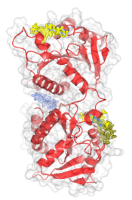
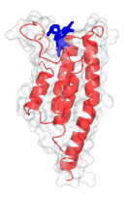
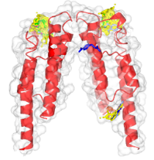
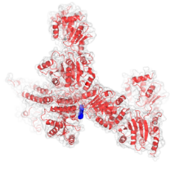
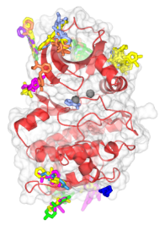
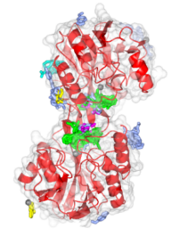
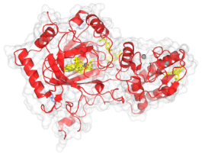
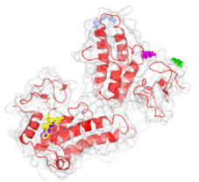
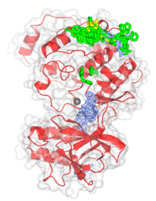
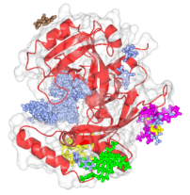
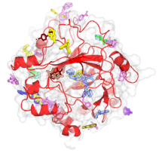
@Diamond: true user programme – regular experiments (>1/wk)
793 hits across 20 targets
2-20% hit rate
(Oct 2016)

Slide 10
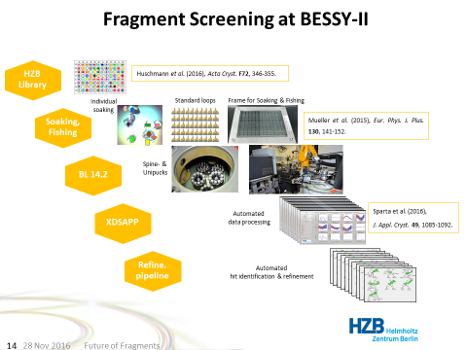


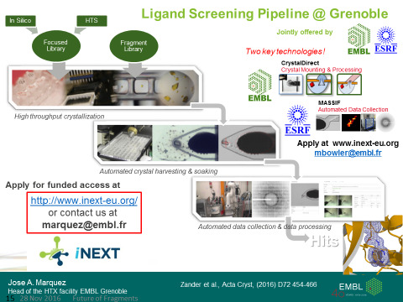
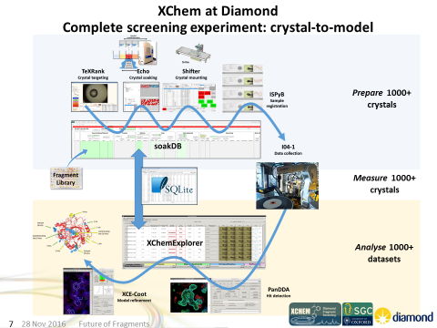
Happening elsewhere
Coming soon via CHNUK:

Slide 11
Why high density pin? XChem in numbers (2017)
29 academic proposals, 6 industrials
Number of crystals shot on I04-1
XChem: 30,998 (~1938 unipucks of 16 pins)
MX: 12,838
Industry: 7,563
Total: 51,399
XChem DSPL library ~600-700 fragments
700 crystals (~44 unipucks of 16 pins)

Slide 12
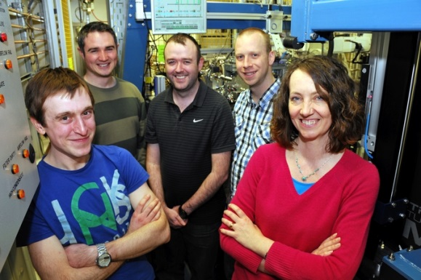
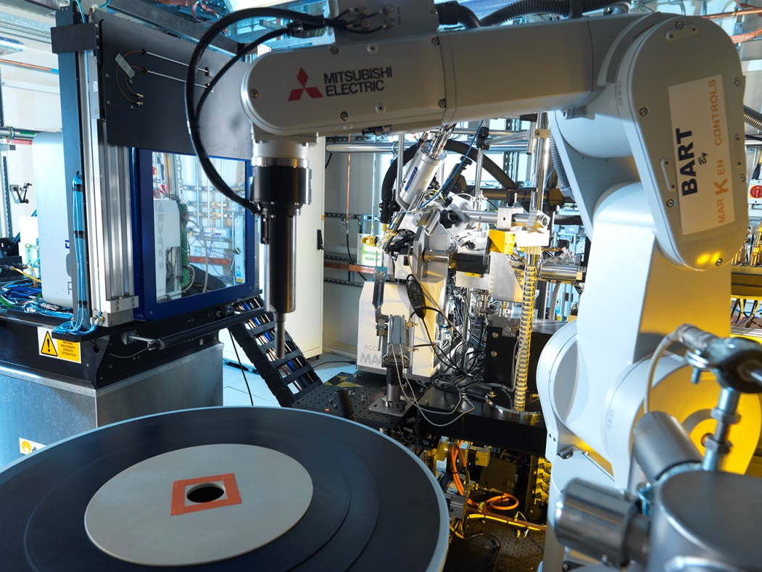
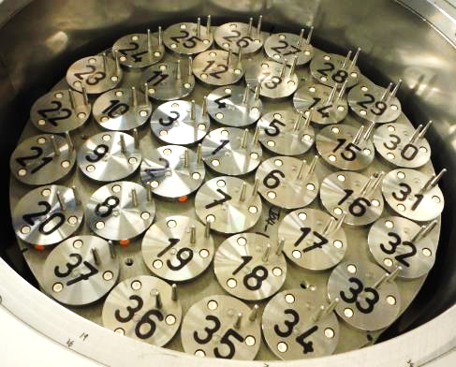
BART robot (I03 team) - transformative
Ken Jones
James O’Hea
Mark Williams
In-house control system:
VERY robust
Fast: <20sec exchange
Stuart Fisher
Katherine McAuley
37 pucks, 592 samples
Notes:
The magic of Diamond
Katherine’s email: “stay away”
Possibly combine into single slide with beamline

Slide 13
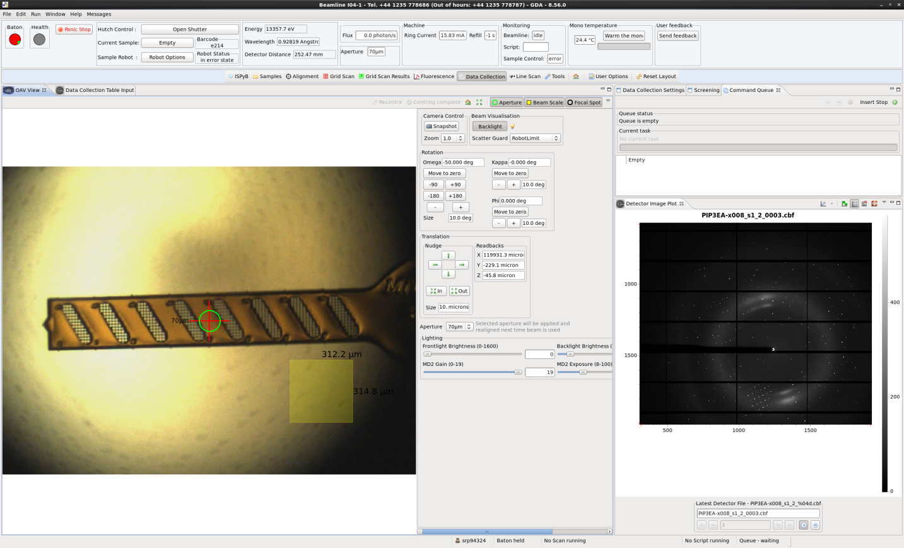

Multiple samples per pin (high density pin)
Mitegen’s multiple sample pins
?
4736 samples in a full BART Dewar.
Current: 1min data, 1min exchange = 30xtals/hr = 720xtals/day
8-crystal: 8min data, 1min exchange = 53xtals/hr = 1278xtals/day
Notes:
Robot optimisation great but can’t keep expanding the dewar size-> therefore high density pin

Slide 14
Other use case
External XChem users replicate labXChem but use synchrotron for data collection
Prepare samples at home lab for the full screen
~ 7 dry shippers (of 7 unipucks cane) for conventional pins but with the high density pin, only need 1 dry shipper for the whole screen!
I23
Samples collected in vacuum.
Process for mounting 1 pin is laborious so it is best to maximise the number of samples loaded onto a single pin.
Industrial users tend to send triplicates and collect from best one

Slide 15


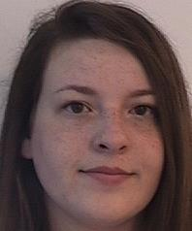
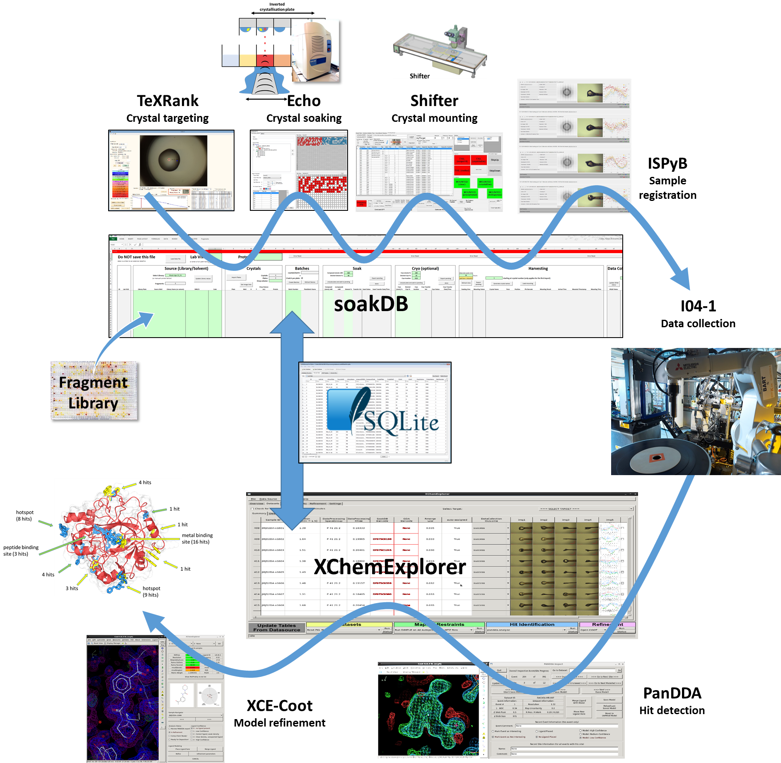
XChem workflow
Patrick Collins
Tobias Krojer
Rachael Skyner
Prepare 1000+ crystals
Measure 1000+ crystals
Analyse 1000+ datasets
Notes:
Add photo Patrick, Tobias, Rachael, OLT logo

Slide 16
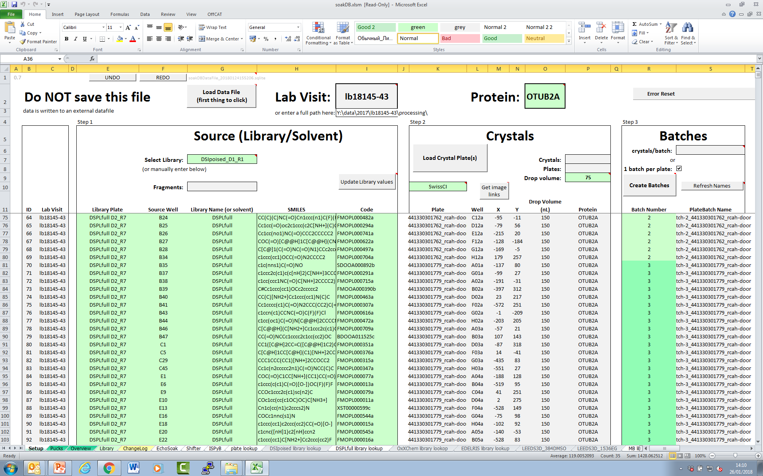
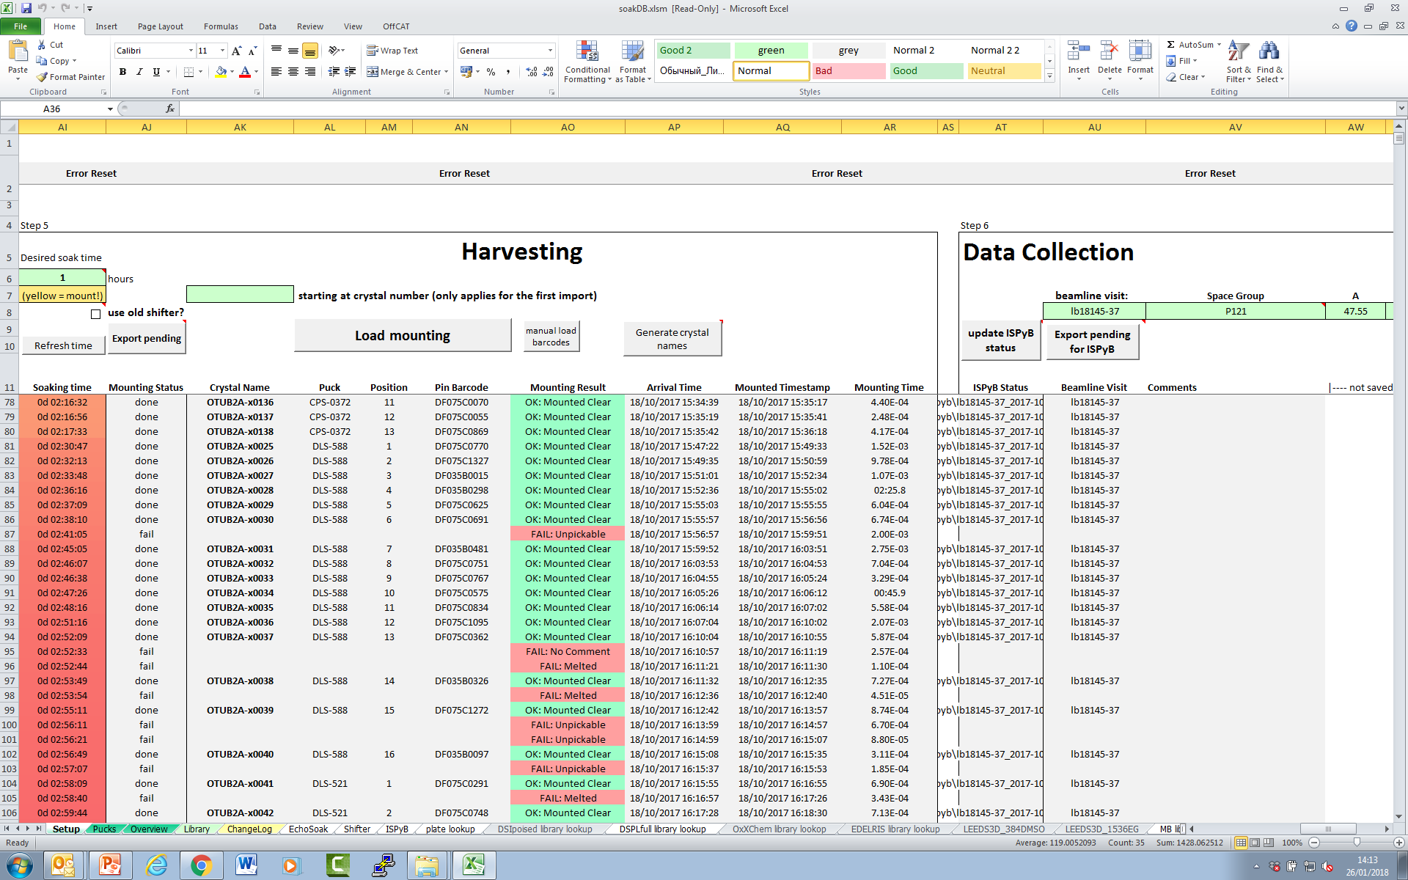
SoakDB

Slide 17
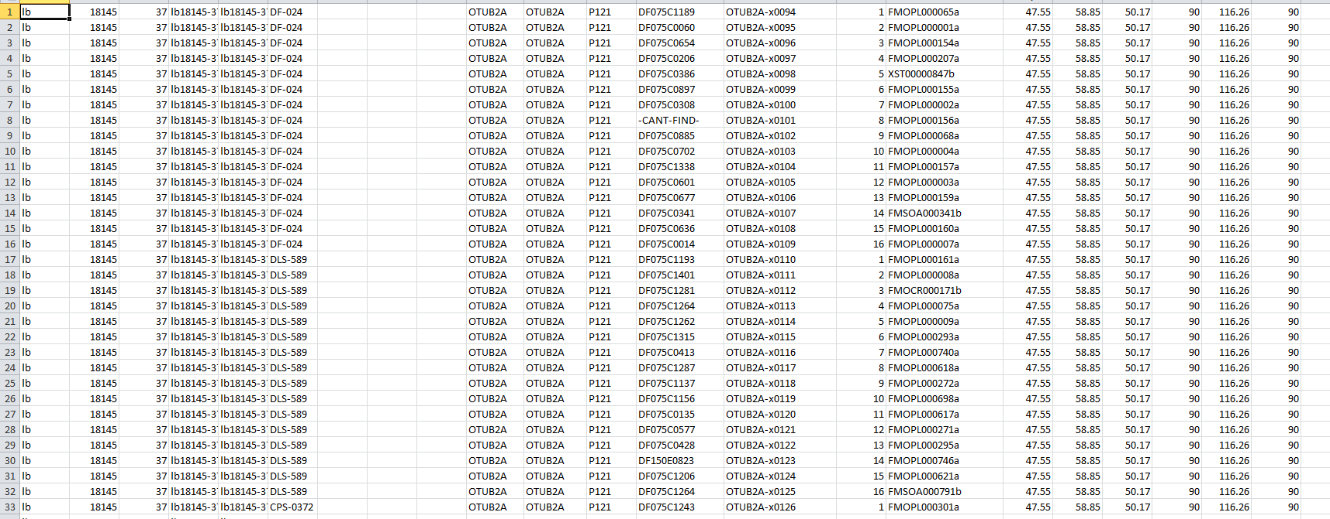
Csv file to upload into ISPyB
barcode
Pin position
Comment
Holder
Protein name
Sample name
Notes:
Holder + pin position, for GDA to do the experiment on the sample
Protein acronym + sample name to define directories + prefixes
Compound name in comments are of ispyb to link crystal number and compound.

Slide 18
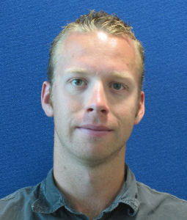
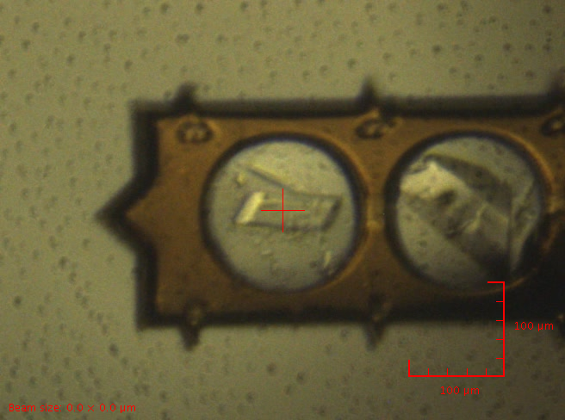
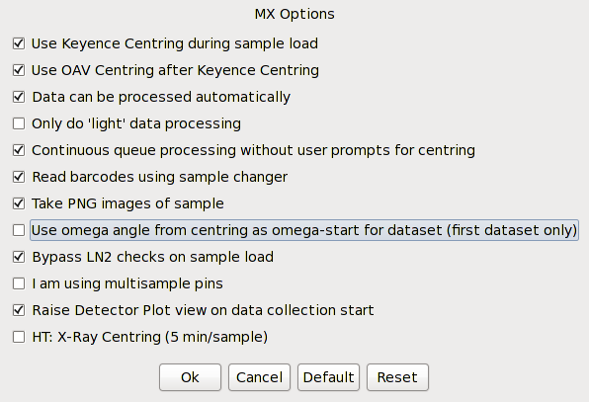
High density pin auto-centring
Find the tip
For each data collection being set, it will:
Move the pin by 187um
Do face-on then side-on similarly to OAV centring
Mark Williams

Slide 19
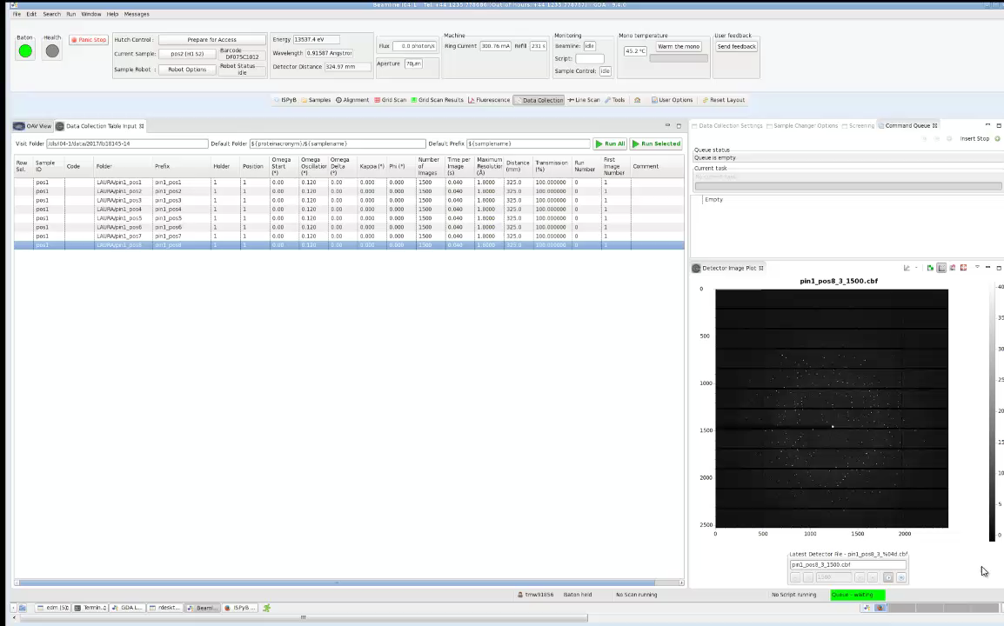
High density pin in unattended mode

Slide 20
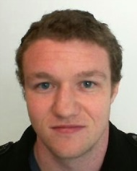
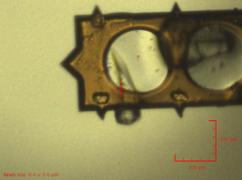
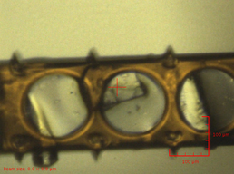
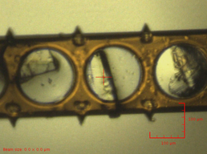
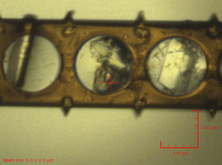
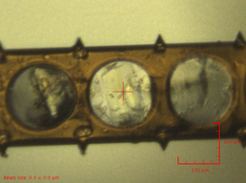
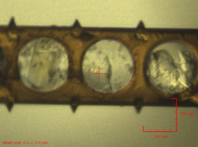


Real case: Soaking with compounds
Joel McMillan
Data collected, compound found!
20

Slide 21

What is missing?
Compatibility with shifter software: partially (missing sub-location and loop type)
Compatibility with SoakDB: in progress. Workaround is manual and tedious in form of pin 1 – positions 1 to 8
Uploading information to ISPyB
=> Our needs: flexible uploading mean
Compatibility with ISPyB & GDA: tedious - manual – filling manually folder and prefix with different crystal numbers JOELS/JOELS-x0001 for holder 1, pin 1, sub-loc 1. JOELS/JOELS-x0002 for holder 1, pin 1, sub-loc…etc…
=> 3 extra columns in ISPyB (sub-location|loop type|(container))
Running auto-centring unattended (optical mode): √ (would be better with x-ray centring)
No unique feedback on each individual dataset!

